Slide 1

Chapter 1
K. K. Wagh Polytechnic, Nashik-3
Basics of JavaScript Programming
CO505.1: Develop Programs Using PHP

Slide 2
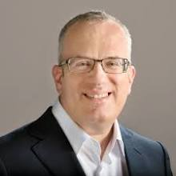
Brendan Eich is an American computer programmer and technology executive. He created the JavaScript programming language and co-founded the Mozilla project, the Mozilla Foundation, and the Mozilla Corporation.

Slide 3
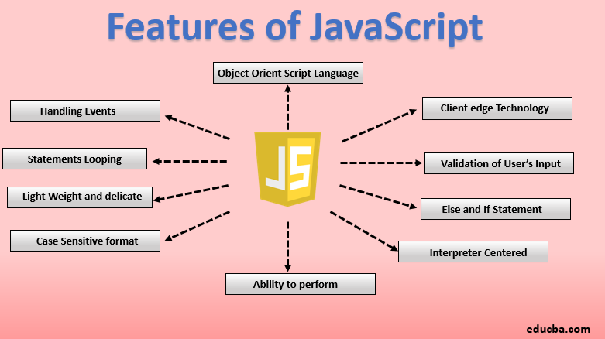

Slide 4
Overview of JavaScript:
It is dynamic Computer Programming language
Lightweight and most commonly used for web pages.
It interact with user and make a web page dynamic.
Using HTML only static pages can be created.
No user interaction with HTML
JavaScript was developed by Netscape in 1995.
Its initial name was LiveScript.
Later on Sun Microsystems joined Netscape and the name is changed to JavaScript.

Slide 5
Features of JavaScript:
Browser Support: No plug-in needed. Almost all browsers support
Structure Programming Syntax: Similar to ‘C’
Automatically inserts ‘;’ at the end of statement. No need to write.
Dynamic Typing: Data type is bound to value not to variable. Ex: one can assign integer value to any variable say ‘a’ and later can assign string value to same variable ‘a’.
Run time Evaluation: ‘eval’ function can be used in expression

Slide 6
Features of JavaScript cont.:
Support for object: It is Object Oriented Programming language
Regular Expression: Supports use of regular expression using which text-pattern matching can be done.
Function Programming: In this functions can be used. One function can use other or can be assigned to a variable just like some data type.

Slide 7
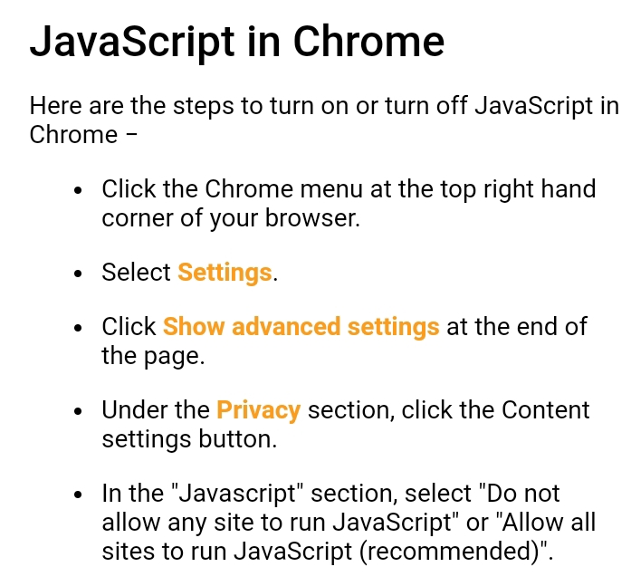
Enabling JavaScript for various Browsers:

Slide 8
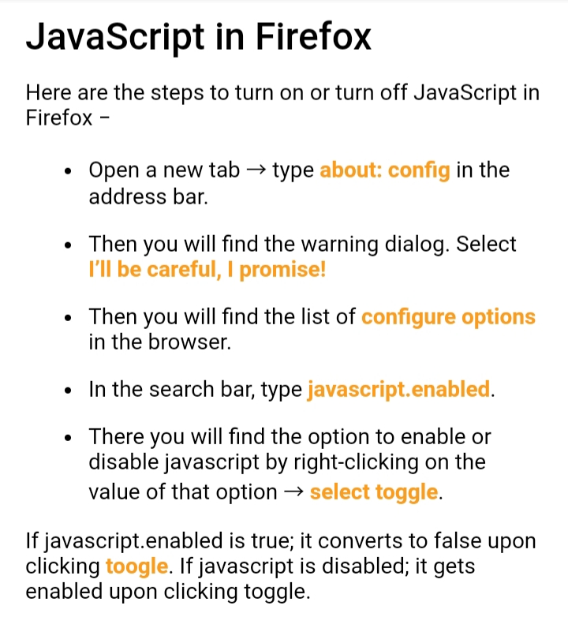
Enabling JavaScript for various Browsers:

Slide 9
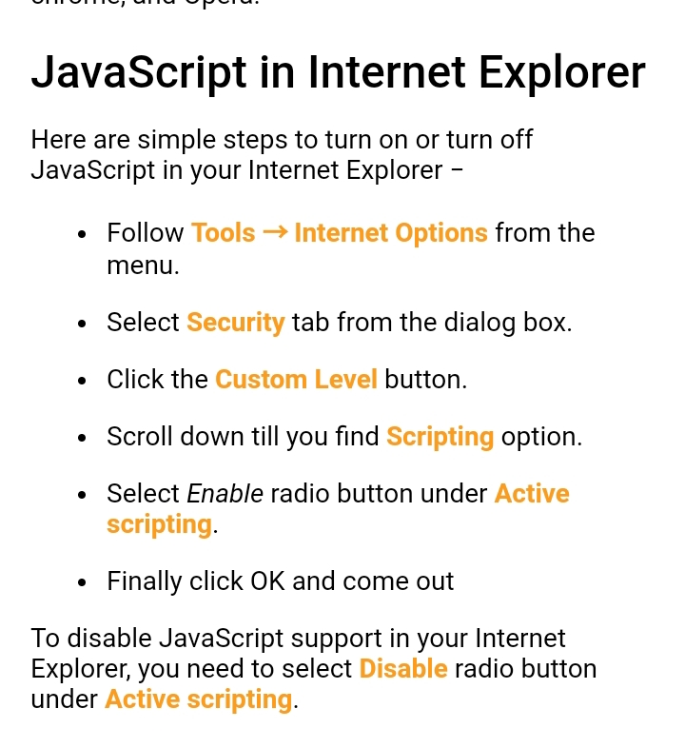
Enabling JavaScript for various Browsers:

Slide 10
Writing a JavaScript Document :
The javascript can be directly embedded within HTML document or it can be stored as external file.
Syntax:
<script type=“text/javascript”>
------------
-------------
</script>
Two attributes of <script> tag are:
type: <script type=“text/javascript”>
</script>
language: <script language=“javascript”>
</script>

Slide 11
Writing a First Program:
<html>
<head></head>
<body>
<script type="text/javascript">
document.write("HELLO WORLD");
</script>
<p>this is web page body</p>
</body>
</html>

Slide 12
Explanation of Program:
We have embedded a javascript within
<script type=“=“text/javascript”>
----------
</script>
A comment can be
//
/* */ or can use XHTML comment
<! -- > and < -->
document.write is used to display desired message on web browser.
To run the program
Open any web browser and type complete name of file on the
address bar.

